Slide 1
TALENT ACQUISITION AND OPERATIONS, INSTRUCTIONAL
CERTIFICATION
Charter Training
March 8, 2023
Notes:
WELCOME
INTRODUCTIONS

Slide 2
TOPICS
Establishing Eligibility
Certificate Issuance
Temporary Certificate Upgrade
Professional Renewal
Out-of-Field
Talent acquisition and operations, instructional

Slide 3
Certificate Eligibility
Statement of Status of Eligibility must indicate applicant is eligible
A Statement of Status of Eligibility is not the same as a certificate
Talent acquisition and operations, instructional

Slide 4
Sample of Status Statement ‘Eligible’
Talent acquisition and operations, instructional

Slide 5
Sample of FLDOE Certificate
Talent acquisition and operations, instructional

Slide 6
Security Background Check
Fingerprint processing and background checks for charter school applicants will be performed by FieldPrint. Instructions can be found at http://www.fieldprintflorida.com/
The hiring location must provide the applicant with the FieldPrint code in advance of the applicant registering to be fingerprinted. If you have questions regarding the FieldPrint fingerprinting process, contact FieldPrint via one of the following methods:
Phone: (877)614-4364 Email: CustomerService@fieldprint.com
Talent acquisition and operations, instructional

Slide 7
Certificate Issuance Request
Certificate Issuance Request Form for Charter School New Hires must have all sections completed with a fingerprint authorization date prior to employment date.
Email completed form at the time of hire to certificationrequests@browardschools.com
Charter School Information including Certification Issuance Request Form and Fingerprints Instructions at https://www.browardschools.com/Page/35691
Please review video guide at link above when completing the Certificate Issuance Request prior to submitting a request to our office to ensure it is filled out correctly and to avoid processing delays.
You will receive an email from our office acknowledging receipt of your request.
It is the charter school’s responsibility to follow up to ensure FLDOE certificate is issued.
Talent Acquisition and operations, Instructional

Slide 8
Temporary Certificates
Florida state statute and administration code require that all instructional staff employed at a Florida public school hold a valid educator certificate.
Temporary certificates are non-renewable and are valid for a three-year period only.
Upon completion of the three-year period, certificate holders must have completed all requirements to upgrade to a professional, renewable certificate.
TALENT ACQUISITION AND OPERATIONS, INSTRUCTIONAL 8

Slide 9
Upgrade Requirements
The Statement of Status of Eligibility lists ALL requirements that must be completed to upgrade to a professional certificate. Teachers can obtain a copy of their Statement by viewing “Documents” from the quick start menu at the FLDOE.
Professional Preparation
Documentation of completion of training in the methodology, pedagogy, theories, and practices of instruction.
Competencies
Documentation of accomplished in-practice skills related to instruction.
General Knowledge
Documentation of knowledge in four basic areas: math, reading, English, and an essay component.
Professional Education
Documentation of knowledge in professional pedagogy in the teaching profession.
Subject Area
Documentation of knowledge in the subject area(s) you are seeking to obtain a professional certificate in.
TALENT ACQUISITION AND OPERATIONS, INSTRUCTIONAL

Slide 10
Options
There are several options available through which teachers can satisfy the exams and coursework requirements to upgrade to a professional certificate.
Exams are offered in computer-based format only
Exam information, test center locations, and registration is obtained at www.fl.nesinc.com
TALENT ACQUISITION AND OPERATIONS, INSTRUCTIONAL

Slide 11
General Knowledge Options
Passing score on (all portions of) the Florida General Knowledge Test earned no more than ten (10) years prior to the date of application
Conferred master’s or higher degree from an accredited institution.
A valid (unexpired) professional teaching certificate issued by a US state or territory
A valid (unexpired) certificate issued by the National Board for Professional Teaching Standards or the American Board for Certification of Teacher Excellence
Completion of two semesters of full-time (or the equivalent in part-time) college teaching experience
Achievement of passing scores on the GRE® revised General Test (must be test date of 7/1/2015 or after)
GRE Analytical Writing combined score of 4 out of 6 acceptable for GK Essay
GRE Quantitative Reasoning scaled score of 147 acceptable for GK Math
GRE Verbal Reasoning scaled score of 151 acceptable for both GK English and GK Reading
TALENT ACQUISITION AND OPERATIONS, INSTRUCTIONAL

Slide 12
Subject Area Exam Options
Passing score on the appropriate subject area examination earned no more than ten (10) years prior to the date of application
A valid (unexpired) professional teaching certificate issued by a US state or territory
A valid (unexpired) certificate issued by the National Board for Professional Teaching Standards or the American Board for Certification of Teacher Excellence
For select World Languages:
American Council on the Teaching of Foreign Languages (ACTFL) examinations may be used in world languages without a Florida subject area examination. Acceptable if earned no more than ten (10) years prior to the date of application. For more information, visit ACTFL.
Defense Language Proficiency Tests (DLPT) may be used in world languages except Latin. Acceptable if earned no more than ten (10) years prior to the date of application.
OR
Completion of the Basic Program of the Defense Language Institute of the United States, Department of Defense. For more information, visit The Defense Language Institute Foreign Language Center.
TALENT ACQUISITION AND OPERATIONS, INSTRUCTIONAL

Slide 13
Professional Education Exam Options
Passing score on the Florida Professional Education Test earned no more than ten (10) years prior to the date of application
A valid (unexpired) professional teaching certificate issued by a US state or territory
A valid (unexpired) certificate issued by the National Board for Professional Teaching Standards or the American Board for Certification of Teacher Excellence
Completion of a professional preparation (education competency) program and achieved an annual evaluation rating of Highly Effective
NOTE: The professional competencies (listed as a separate requirement) are documented via a checklist, called the State Competency Demonstration Checklist, which the principal completes and submits to Talent Acquisition and Operations.
TALENT ACQUISITION AND OPERATIONS, INSTRUCTIONAL

Slide 14
Professional Preparation Coursework
Minimum of 15.00 semester hours in education courses with credit in each of the professional education areas listed below. Please note that it may require more than the minimum semester hours to satisfy all requirements:
Classroom management with a focus on creating safe learning environments
Child and adolescent development including theories and principles of learning
Educational assessment practices that include analysis and application of data from statewide standardized assessments
Effective instructional techniques, strategies, and materials to meet the needs of diverse learners, including students with disabilities
Applications of research-based instructional practices in reading
Instructional strategies for teaching students of limited English proficiency (teaching experience cannot be used to satisfy this requirement.)
TALENT ACQUISITION AND OPERATIONS, INSTRUCTIONAL

Slide 15
Sample Statement: Professional Preparation Courses
Completion of the following Professional Preparation Coursework Requirements:
a minimum of 15.00 semester hours in education courses with credit in each of the professional education areas listed below. Please note that it may require more than the minimum semester hours to satisfy all requirements.
classroom management with a focus on creating safe learning environments for students in which effective teaching and learning can take place by promoting a physically, emotionally, socially, and academically secure climate for students
child and adolescent development including theories and principles of learning
educational assessment practices that include analysis and application of data from statewide standardized assessments and other multiple sources to improve instruction and learning
effective instructional techniques, strategies, and materials to meet the needs of diverse learners, including students with disabilities
instructional strategies for teaching students of limited English proficiency including instruction in the English language and development of the student's mastery of the four language skills of listening, speaking, reading, and writing (Teaching experience cannot be used to satisfy this requirement.)
applications of research-based instructional practices in reading (May only use experience in teaching Reading or Elementary Education to satisfy this requirement).
practical experience in teaching by completing one year of full-time experience teaching in an elementary or secondary school (Maximum of one year of teaching experience can be applied.)
TALENT ACQUISITION AND OPERATIONS, INSTRUCTIONAL

Slide 16
Professional Preparation Coursework Options
Completion of a state-approved teacher preparation program from a Florida institution
Completion of a teacher preparation program from an out-of-state accredited or approved institution
A valid (unexpired) professional teaching certificate issued by a US state or territory
A valid (unexpired) certificate issued by the National Board for Professional Teaching Standards or the American Board for Certification of Teacher Excellence
Completion of specified education courses with grades of at least "C"
Completion of a state-approved alternative certification program
Completion of two semesters of full-time (or the equivalent in part-time) college teaching experience
Master's or higher degree in a science, technology, engineering or math (STEM) field, certification in a grades 6-12 STEM area, a highly effective evaluation rating based on student performance on a state or national assessment for an approved STEM high school course
TALENT ACQUISITION AND OPERATIONS, INSTRUCTIONAL

Slide 17
Alternative Certification Pathways
ACE Alternative Certification for Educators
Description: A Professional Development Certification Program (PDCP) that is approved by the Florida Department of Education (FDOE). All the education semester hours listed on the Statement of Status of Eligibility (SOE) are satisfied through ACE when all tasks/assignments are successfully completed.
Requirements: Full-time classroom teacher; satisfied GK exam; have a valid Temporary Teaching Certificate; MUST be teaching “in-field”
Recommended for those with 15 semester hours (5-6 courses) coursework needed
Cost: None
BEC (Broward Educator Certification)
Description: A course‐by‐course one‐year pathway where teachers only take the classes needed towards earning a Professional Certificate. BEC is available at Broward College (BC) and Florida Atlantic University (FAU) and are aligned to the Florida Educator Accomplished Practices (FEAPs).
Requirements: Full-time instructional teacher; have a valid Temporary Teaching Certificate
Recommended for those with 12 semester hours or less (1-4 courses) coursework needed
Cost: Application fee and course materials
For information contact: alternativecertification@browardschools.com
TALENT ACQUISITION AND OPERATIONS, INSTRUCTIONAL

Slide 18
The Upgrade Application Process
Once a teacher has completed all requirements listed on their Statement of Status of Eligibility, they are ready to apply for an upgrade to a professional certificate!
Teachers must ensure all documentation verifying completion of their requirements have been submitted to the FLDOE
Teachers submit the upgrade application and fee online via the FLDOE web site at: https://flcertify.fldoe.org/datamart/login.do
Email Teaching Experience Verification (CT-113) and State Competency Demonstration Checklist (CDC)Forms to certificationrequests@browardschools.com verifying one year of experience to satisfy one of the professional preparation coursework except for limited English proficiency course and reading course (if not teaching reading or elementary education).​
​Teachers should be patient! It may take approximately eight weeks for the FLDOE to respond.
TALENT ACQUISITION AND OPERATIONS, INSTRUCTIONAL

Slide 19
Extensions for Temporary Certificate Holders
Teachers should make best efforts to satisfy all requirements to upgrade to a professional certificate; extensions will not be considered until approximately March
Teachers who need to request an extension:
Must speak with their principal; principal to review what requirements the teacher has completed to date (e.g. teacher should have completed a significant portion of upgrade requirements to show due diligence)
Teacher must submit letter indicating detailed reason(s) on need for extension to principal
Teacher must submit supporting documentation to principal (required if request for extension is related to medical reasons)
Teacher needs to complete a CT 105 form required by FLDOE
Principal must obtain letter from the head of the charter school’s governing board (must be on charter letterhead, must include the request for extension and the reason, teacher’s certificate number, last four numbers of teacher’s social security number, and must be signed)
Principal must submit extension request, list of all requirements (exams and required courses) the teacher has competed toward their professional certificate to date, teacher’s letter of explanation, completed CT105 form, letter from head of charter board, and all supporting documentation to: certificationrequests@browardschools.com with subject: “Charter Request for Extension”
NOTE: The inability to pass an exam is not a valid reason to request an extension
TALENT ACQUISITIONS AND operations, instructional

Slide 20
Extensions for Temporary Certificate Holders (cont’d)
Once TAO has reviewed the extension request, TAO will:
Submit charter board letter to the FLDOE officially requesting the extension
Open an extension application for the teacher at the FLDOE
Send the teacher an email requesting the teacher submit the associated application fee (required after the extension application is opened by TAO)
TAO will upload form CT105 to the FLDOE
Extensions to temporary certificates are for two years
TALENT ACQUISITIONS AND operations, instructional

Slide 21
Extensions for Temporary Certificate Holders (cont’d)
Highly Effective Rating:
Teacher must have copy of most recent evaluation indicating an overall rating of Highly Effective
Teacher must complete CT105 Form required by the FLDOE
Principal must obtain letter from the head of the charter school’s governing board
(must be on charter letterhead, must include the request for extension and the reason, teacher’s certificate number, last four numbers of teacher’s social security number, and must be signed)
Principal to submit copy of evaluation, completed CT105 form, and letter from head of charter board to: certificationrequests@browardschools.com with subject: “Charter Request for Extension”
Once TAO has reviewed the extension request, TAO will:
Submit charter board letter to the FLDOE officially requesting the extension
Open an extension application for the teacher at the FLDOE
Send the teacher an email requesting the teacher submit the associated application fee (required after the extension application is opened by TAO)
TAO will upload form CT105 to the FLDOE
TALENT ACQUISITIONS AND operations, instructional

Slide 22
General Notes/Reminders:
Out-of-field training requirements (including those related to ESOL) are not associated with satisfying requirements to upgrade to a professional certificate.
The FLDOE automatically receives FTCE exam score reports.
The FLDOE will only accept transcripts as official if they receive original hard copy transcripts OR if they receive electronically transmitted transcripts through the SPEEDE or FASTER systems.
If in doubt about whether a course is applicable toward satisfying a professional preparation course requirement, teachers should contact the FLDOE at FLCertify@fldoe.org - must have available the university name, course title and prefix, and course description.
TALENT ACQUISITION AND OPERATIONS, INSTRUCTIONAL

Slide 23
Professional Certificate Renewals
Florida state statute and administration code require that all instructional staff employed at a Florida public school maintain a valid educator certificate.
Renewals require completion of 120 district in-service points OR six semester hours of college credit OR a combination of in-service and college credit.
Credit must have been earned within the validity period of the certificate to be renewed.*
For those renewing a Florida (state-issued) certificate, the 120-point total must include 20 points in students with disabilities (SWD) training.
Beginning with certificates expiring 6/30/2025 that are in the subjects of Elem Ed, ESE, English, and/or ESOL will be required to have completed 40 in-service points in reading instruction.
*In-service points or college credit earned in the areas of ESOL, Students With Disabilities, or Reading from a previous period and that have not been used to meet eligibility for a previous renewal may be used toward meeting requirements.
TALENT ACQUISITION AND OPERATIONS, INSTRUCTIONAL

Slide 24
Options
Acceptable College Credit Equivalencies for Renewal
Every 20 in-service points are equivalent to one semester hour of college credit.
A passing numerical score on the Florida subject area exam specific to the coverage to be renewed is equivalent to three (3) semester hours of college credit for renewal purposes.
When the certificate includes Exceptional Student Education, Visually Impaired, Hearing Impaired, or Speech-Language Impaired, a passing score on the corresponding Florida subject area exam satisfies the requirement for credit in teaching SWD and a total of three semester hours of renewal credit.
A valid certificate issued by the National Board for Professional Teaching Standards will renew the Florida certificate in the subject shown on the national certificate.
An Exceptional Needs Specialist certificate issued by the National Board for Professional Teaching Standards satisfies the requirement for credit in teaching SWD, when the Florida professional certificate includes a subject in instructing students with disabilities.
Teaching a college level course at an acceptable institution may be accepted the same as credit earned for that course.
TALENT ACQUISITIONS AND operations, instructional

Slide 25
Students with Disabilities (SWD) Training
A minimum of 20 in-service points or one semester hour in students with disabilities training is required every renewal period as part of the total renewal requirements.
Option 1: Independent Online Study Modules through the BEESS Portal
An independent study course. To access go to www.fl-pda.org - on the right side under Independent study, select Register/Sign-in to create an account and then enroll. Broward Country receives a report of course completers and will process the in-service credit.
To verify which courses meet the SWD requirement, contact Carol Beitler, FDLRS Program Specialist at 754.321.3400.
Option 2: Learning Across Broward (LAB) Courses
Login to LAB (Learning Across Broward) and do an advanced search for courses that meet the ESE renewal requirement (also called SB1108) to find a course that meets the teacher’s professional learning goals.
TALENT ACQUISITIONS AND operations, instructional

Slide 26
Application Process
Step | Instructions
1 | Apply online to the state at http://www.fldoe.org/teaching/certification/on-line-application-status-lookup-site.stml Before submitting their Renewal application, teachers must verify that District Affiliation accurately reflects Broward. The code for Broward is 6.
2 | Teachers pay the renewal fee via the district’s website at https://osp.osmsinc.com/browardfl/. Select "Departments" from the menu at the top, then select "Certification Applications".
3 | Teachers email the payment confirmation page with personnel number written on it to TAO at Certificationrequests@browardschools.com. If using college courses, submit official transcripts to Talent Acquisition & Operations (Instructional) at 600 SE 3rd Avenue, Fort Lauderdale, FL 33301. If teachers do not provide payment confirmation to us, we will not know that they have submitted their renewal application to the State. Their payment confirmation will alert us that they have an application that needs to be processed.
4 | In approximately eight weeks, they will receive an email from the Florida Department of Education notifying them that your certificate has been renewed and is available for teachers to download.
5 | Teachers should provide a copy of their certificate to their principal/administrator.
TALENT ACQUISITION AND OPERATIONS, INSTRUCTIONAL

Slide 27
Extensions
Teachers should make best efforts to satisfy all requirements to renew their professional certificate.
Professional Certification can be extended one year due to extraordinary circumstances.
Teachers submit “Medical Extension Request for Professional Educator” application and fee to State. www.fldoe.org/edcert
Application must be submitted even if circumstances are not medical in nature
If circumstances are medical in nature, a brief doctor’s note must be uploaded to their file (this is done by the teacher when they apply)
TALENT ACQUISITIONS AND operations, instructional

Slide 28
General Notes/Reminders:
If a teacher is using in-service to meet renewal requirements, they must verify the in-service appears in their LAB record.
The Florida Department of Education DOES NOT advise the district of who has applied for renewal or who has been issued a renewed certificate. Teachers are responsible for communicating with their location.
If a teacher has completed SWD training and have the Certificate of Completion but the points do not yet appear in their in-service record, they must submit a scanned copy of the Certificate of Completion to certificationrequests@browardschools.com
Teachers should advise our office that they have applied for renewal and paid the associated fee by submitting a copy of the payment verification to certificationrequests@browardschools.com
TALENT ACQUISITION AND OPERATIONS, INSTRUCTIONAL

Slide 29
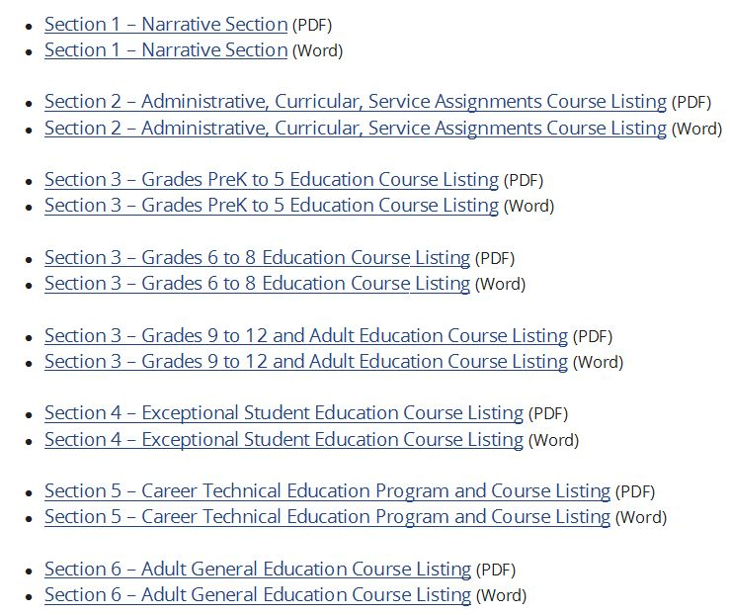
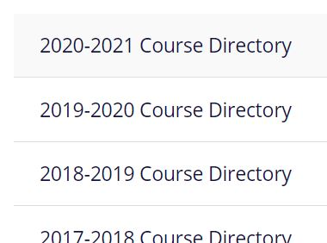
Out-of-Field Identification and Process
The Florida Course Code Directory
Florida Course Code Directory (CCD) http://www.fldoe.org/articulation/CCD/
All courses funded through the Florida Education Finance Program and courses for which students may earn credit toward high school graduation
Indicates acceptable certification(s) by course
CCD is separated by sections and includes general information and courses by grade levels
TALENT ACQUISITION AND OPERATIONS, INSTRUCTIONAL

Slide 30
A Closer Look
Course code number
Course title
Acceptable certifications
TALENT ACQUISITIONS AND operations, instructional

Slide 31
Developmental Language Arts
Course | Acceptable Certifications
Middle Grades Language Arts through ESOL Course Codes: 1002000-1002180 | ESOL (not the Endorsement) Middle Grades English with ESOL Endorsement English 6-12 with ESOL Endorsement Foreign Language (any) with ESOL Endorsement Elementary Education with ESOL Endorsement
Middle Grades Language Arts through ESOL and Reading Course Code: 1002181 | ESOL (not the Endorsement) with Reading Endorsement English 6-12 with ESOL and Reading Endorsements Reading (not the Endorsement) with ESOL Endorsement Middle Grades English with ESOL and Reading Endorsements Elementary Education with ESOL Endorsement Foreign Language (any) with ESOL and Reading Endorsements
High School Language Arts through ESOL Course Codes: 1002300-1002380 and 1002520-1002530 | ESOL (not the Endorsement) English 6-12* with ESOL Endorsement Foreign Language (any) with ESOL Endorsement *Middle Grades English with ESOL Endorsement acceptable for courses 1002300 and 1002305
High School Language Arts through ESOL and Reading Course Code: 1002381 | ESOL (not the Endorsement) with Reading Endorsement English 6-12 with ESOL and Reading Endorsements Reading (not the Endorsement) with ESOL Endorsement Foreign Language (any) with ESOL and Reading Endorsements
TALENT ACQUISITIONS AND operations, instructional

Slide 32
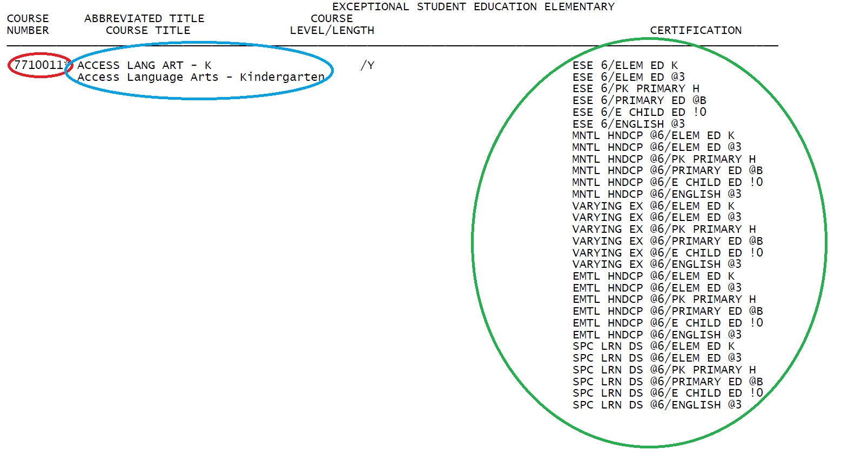
A Closer Look
Course code number
Course title
Acceptable certifications
TALENT ACQUISITIONS AND operations, instructional

Slide 33
ESE Access Courses
Effective with the 2018-2019 school year, the Florida Department of Education requires teachers who are assigned access courses (in a content area - e.g. math, science, language arts, social science) to hold certification in ESE and Elementary Education OR ESE and the specific content area.
TALENT ACQUISITIONS AND operations, instructional

Slide 34
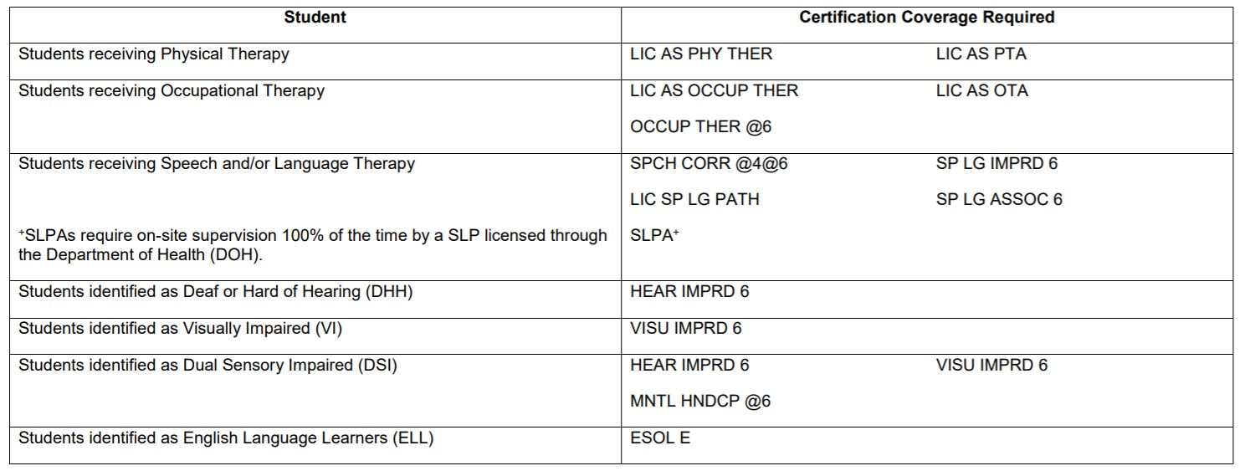
ESE Certification
Student characteristics are considered when determining appropriate certification for ESE teachers. If you are assigned a class where 100% of students are indicated with the same ESE student characteristic you may be required to hold the related, specific ESE certification. Some examples of this are Hearing Impaired and Autism Spectrum Disorder.
TALENT ACQUISITIONS AND operations, instructional

Slide 35
Autism Spectrum Disorder (ASD)
If teachers can meet the experience requirement noted in the option above, the principal must submit an original letter, on school letterhead, indicating the period in which the teacher gained the experience. The letter must include a statement that the teacher worked with ASD students and that the teacher had satisfactory evaluations during the period. The letter must be signed and dated by the principal and submitted to the Talent Acquisition & Operations (Instructional) Department; attn: Certification
TALENT ACQUISITIONS AND operations, instructional

Slide 36
Completing ASD Subject Requirements
The district offers a state-approved endorsement program for the ASD Endorsement (NOTE the ASD Endorsement subject area requirements cannot be met via passing a subject area exam). Further information regarding the state-approved district ASD Endorsement courses is found at: https://fl-pda.org/opportunities/endorsement/
For teachers completing college coursework toward ASD, two years of full-time instructional experience in working with ASD students can be used in lieu of six of the twelve required semester hours. While accruing the required minimum teaching experience with ASD students, teachers must take six semester hours of college coursework to satisfy requirements for two of the following areas: (a), (b), (c), or (d) of the subject requirements. Note one of the courses completed must include field experience. Course requirements are found at the Florida Department of Education web site: http://www.fldoe.org/teaching/certification/administrative-rules/6a-4-01796.stml
TALENT ACQUISITIONS AND operations, instructional

Slide 37
Completing ASD Subject Requirements (cont’d)
To document the experience the principal must complete and submit the Verification of Teaching Experience form to the Talent Acquisition & Operations (Instructional) Department; attn: Certification. The form must document the teacher’s experience in working with ASD students specifically. The form is available for download from the following web address: http://www.broward.k12.fl.us/certification/FormsGen.html
TALENT ACQUISITIONS AND operations, instructional

Slide 38
Prekindergarten Disabilities
TALENT ACQUISITIONS AND operations, instructional

Slide 39
Completing Prek Dis Subject Requirements
The district does not offer professional development for the Prek Disabilities Endorsement. Teachers must take the coursework. Use the following link to review a chart of universities that offer courses toward the Endorsement: http://florida-ese.org/uco/endorsementsESE.aspx. The Prek Disabilities Endorsement may only be added through completion of the required coursework.
Two years of full-time instructional experience in working with ESE students at the prek level can be used in lieu of six of the twelve required semester hours. While accruing the required teaching experience, with prek ESE students teachers must take six semester hours of college coursework to satisfy requirements for two of the following subject requirements: (a), (b), or (c). (Note that requirement (a) consists of a total of six hours and so a year of experience may be used in lieu of three or all six hours depending on the courses completed). Course requirements can be found at the Florida Department of Education web site: http://www.fldoe.org/teaching/certification/administrative-rules/6a-4-01792.stml
TALENT ACQUISITIONS AND operations, instructional

Slide 40
Completing Prek Dis Subject Requirements (cont’d)
To document the experience your principal must complete and submit the Verification of Teaching Experience form to the Talent Acquisition & Operations (Instructional) Department; attn: Certification. The form must document your experience in working with prek ESE students specifically. The form is available for download from the following web address: http://www.broward.k12.fl.us/certification/FormsGen.html
Another option is to pass the Prek/Primary or Preschool Education subject area exam and add the subject to your certificate. Note that if you hold a professional certificate you must pass the Prek/Primary or Preschool Education exam to meet requirements to add the subject to your certificate. Exam information and registration is obtained at: http://www.fl.nesinc.com/index.asp
TALENT ACQUISITIONS AND operations, instructional

Slide 41
Gifted
Teachers assigned to teach a class where 100% of the students in the class have been identified with the Gifted characteristic OR teachers assigned to teach gifted content are required to hold the Gifted Endorsement in addition to subject area certification.
TALENT ACQUISITIONS AND operations, instructional

Slide 42
Identifying Teachers as Out-of-Field
When teachers are assigned a course or student population (e.g. ESOL, ESE, Gifted) for which they do not hold appropriate certification
Compare required certification(s) for assignment against the current certification(s) you hold
Match = infield
No match = out-of-field
Additional considerations a factor with ESE
TALENT ACQUISITIONS AND operations, instructional

Slide 43
Training Requirements
OOF Area | Training Requirements*
ESOL Category 1 | Complete one course (60 in-service points) within the first two years if new (w/in one year if not new) and continue each year OR pass ESOL subject area exam, add ESOL to certificate, and complete 120 ESOL points within three years of addition to certificate
ESOL Category II | Complete one course (60 in-service points) within two years if new; within one year if not new OR pass ESOL subject area exam, add ESOL to certificate, and complete 120 ESOL points within three years of addition to certificate
ESOL Category III | Complete one course (18 in-service points) within two years if new; within one year if not new OR pass ESOL subject area exam, add ESOL to certificate, and complete 120 ESOL points within three years of addition to certificate
Gifted | Complete two courses (120 in-service points) each year
Reading | Complete two courses (120 in-service points) each year or pass the Reading subject area exam and apply to add the Reading Endorsement (addition via passing the exam is valid only if exam passed and application for addition made by 6/30/2024)
All Others | Complete two courses (six college credits) each year OR pass the subject area exam (where a subject area exam exists in the subject)
TALENT ACQUISITIONS AND operations, instructional

Slide 44
OOF Agreement
Course Information: Use Florida Course Code Directory www.fldoe.org/articulation/CCD
List specific student characteristic oof for (ex: Autism Spectrum Disorder, Gifted)
TALENT ACQUISITIONS AND operations, instructional

Slide 45
Compliance with Training is Important Because…
It ensures high quality instruction
It ensures adherence to state mandates
It avoids financial penalties
Important points (as required by the state):
If teachers are assigned as oof the teacher must be Board approved
Best Practice: Teachers are presented with and sign an OOF Agreement when newly identified as oof
Teachers are presented with an OOF Reminder each oof period thereafter after
The parents of all affected students must receive notification that the teacher is oof
Teachers must complete the required training; school to monitor
TALENT ACQUISITION AND OPERATIONS, INSTRUCTIONAL

Slide 46
General Notes/Reminders:
Teachers are required to satisfy state-mandated out-of-field training in their initially identified ESOL Category regardless of whether they continue in the assignment that prompted the ESOL out-of-field.
If a teacher has completed all five Endorsement courses for ESOL, Gifted, or Reading they are still considered out-of-field (and should be presented with an Out-of-Field Notice) until the subject area is added to their certificate.
TALENT ACQUISITION AND OPERATIONS, INSTRUCTIONAL

Slide 47
The School Board of Broward County, Florida
Lori Alhadeff, Chair
Debra Hixon, Vice Chair
Tori Alston
Brenda Fam, Esq
Daniel Foganholi
Dr. Jeff Holness
Sarah Leonardi
Nora Rupert
Dr. Allen Zeman
Earlean C. Smiley, Ed.D.
Interim Superintendent
The School Board of Broward County, Florida, prohibits any policy or procedure which results in discrimination on the basis of age, color, disability, gender identity, gender expression, genetic information, marital status, national origin, race, religion, sex or sexual orientation. The School Board also provides equal access to the Boy Scouts and other designated youth groups. Individuals who wish to file a discrimination and/or harassment complaint may call the Director, Equal Educational Opportunities/ADA Compliance Department & District’s Equity Coordinator/Title IX Coordinator at 754-321-2150 or Teletype Machine (TTY) 754-321-2158.
Individuals with disabilities requesting accommodations under the Americans with Disabilities Act Amendments Act of 2008, (ADAAA) may call Equal Educational Opportunities/ADA Compliance Department at 754-321-2150 or Teletype Machine (TTY) 754-321-2158.
browardschools.com

